Slide 1
Generative Adversarial Learning
2018年春节学期
王津
2018-6-28

Slide 2
Outline
Discriminative model vs. Generative model
A “good” teacher and a “bad” student
Generative Adversarial Networks (GAN)
Deep Convolutional GAN (DCGAN)
Programming tasks
GAN、DCGAN in MNIST

Slide 3
Discriminative model vs. Generative model
Discriminative model
Take the features as input, and classify which class the sample is belong to.
P(class|features)
Generative model
Use a random assigned (latent) variable to generate features belong to a pre-defined class.
P(class, features) = P(class|features)P(features)

Slide 4
Discriminative model vs. Generative model
Discriminative model
Classification model
SVM、Logistic Regression、Neural Networks

Slide 5
Discriminative model vs. Generative model
Generative Models
Auto-encoder、Conditional Random Field

Slide 6
A “good” teacher and a “bad” student

Slide 7
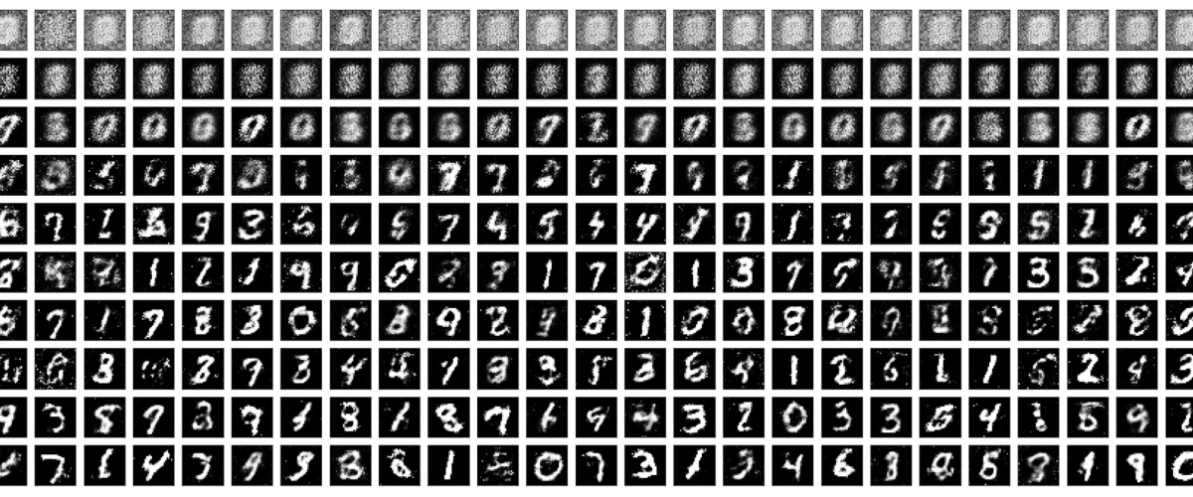
Generative Adversarial Networks (GAN)
Generator
Discriminator

Slide 8
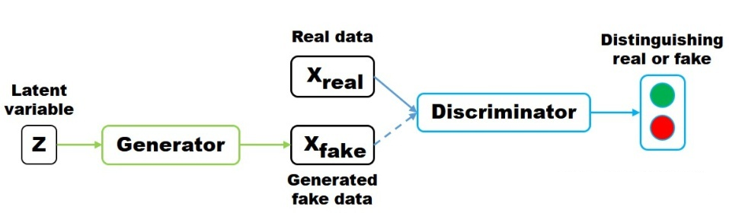
Generative Adversarial Networks (GAN)
Given real image, D should predict label = 1
Given fake image, D should predict label = 0
Given the generated image, G hope D predict label = 1

Slide 9
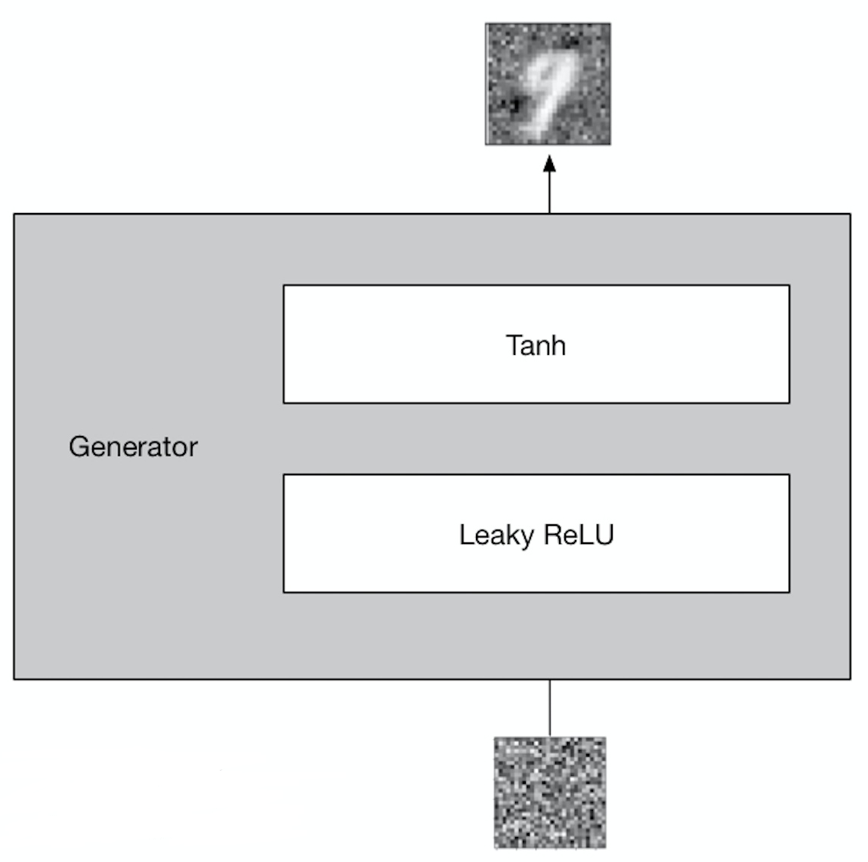
Generative Adversarial Networks (GAN)
Generator

Slide 10
Generative Adversarial Networks (GAN)
Leaky ReLU
Leaky ReLU allows a small, non-zero gradient when the unit is not active.
Note that if we define , this is equivalent to

Slide 11
Generative Adversarial Networks (GAN)
def create_generator(latent_dim, img_shape=(28, 28)):
sequence = Input(shape=(latent_dim, ), dtype='float32')
model = Dense(256)(sequence)
model = LeakyReLU(alpha=0.2) (model)
model = BatchNormalization(momentum=0.8)(model)
model = Dense(512)(model)
model = LeakyReLU(alpha=0.2) (model)
model = BatchNormalization(momentum=0.8)(model)
model = Dense(512)(model)
model = LeakyReLU(alpha=0.2) (model)
model = BatchNormalization(momentum=0.8)(model)
model = Dense(np.prod(img_shape), activation='sigmoid')(model)
output = Reshape(img_shape)(model)
model = Model(inputs=sequence, outputs=output)
model.summary()
return model

Slide 12
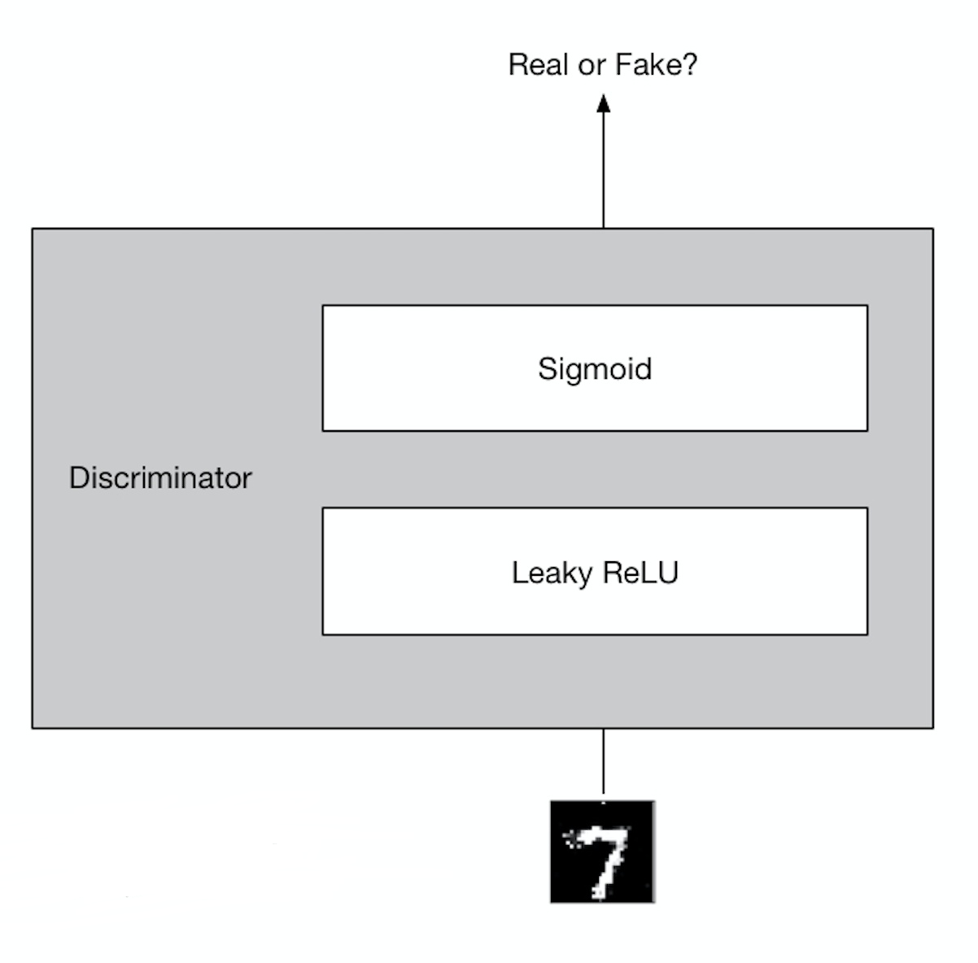
Generative Adversarial Networks (GAN)
Generator

Slide 13
Generative Adversarial Networks (GAN)
def create_discriminator(img_shape=(28, 28)):
sequence = Input(shape=img_shape)
model = Flatten()(sequence)
model = Dense(512)(model)
model = LeakyReLU(alpha=0.2)(model)
model = Dense(256)(model)
model = LeakyReLU(alpha=0.2)(model)
output = Dense(1, activation='sigmoid')(model)
model = Model(inputs=sequence, outputs=output)
model.summary()
return model

Slide 14
Generative Adversarial Networks (GAN)
Combined Model
discriminator = create_discriminator()
discriminator.compile(loss='binary_crossentropy',
optimizer='adam',
metrics=['accuracy'])
discriminator.trainable = False
generator = create_generator(latent_dim, )
z = Input(shape=(latent_dim, ))
img = generator(z)
validity = discriminator(img)
combined = Model(z, validity)
combined.compile(loss='binary_crossentropy', optimizer='adam')

Slide 15
Generative Adversarial Networks (GAN)
Load Data
train_file = os.path.join('data', 'train.csv')
x_train, y_train = load_train_data(train_file)
x_train = np.reshape(x_train, (x_train.shape[0], 28, 28))
batch_size = 32
epochs = 30000
latent_dim = 28*28
sample_interval = 200
valid = np.ones((batch_size, 1))
fake = np.zeros((batch_size, 1))

Slide 16
Generative Adversarial Networks (GAN)
Show images
def sample_images(epoch, latent_dim, generator):
r, c = 5, 5
noise = np.random.normal(0, 1, (r * c, latent_dim))
gen_imgs = generator.predict(noise)
print(gen_imgs.shape)
fig, axs = plt.subplots(r, c)
cnt = 0
for i in range(r):
for j in range(c):
axs[i,j].imshow(gen_imgs[cnt, :,:], cmap='gray')
axs[i,j].axis('off')
cnt += 1
fig.savefig("images/%d.png" % epoch)
plt.close()

Slide 17
Generative Adversarial Networks (GAN)
Training
for epoch in range(epochs):
idx = np.random.randint(0, x_train.shape[0], batch_size)
imgs = x_train[idx]
noise = np.random.normal(0, 1, (batch_size, latent_dim))
gen_imgs = generator.predict(noise)
# Train the discriminator
d_loss_real = discriminator.train_on_batch(imgs, valid)
d_loss_fake = discriminator.train_on_batch(gen_imgs, fake)
d_loss = 0.5 * np.add(d_loss_real, d_loss_fake)
noise = np.random.normal(0, 1, (batch_size, latent_dim))
g_loss = combined.train_on_batch(noise, valid)
print ("%d [D loss: %f, acc.: %.2f%%] [G loss: %f]" % (epoch, d_loss[0], 100*d_loss[1], g_loss))
if epoch % sample_interval == 0:
sample_images(epoch, latent_dim, generator)

Slide 18
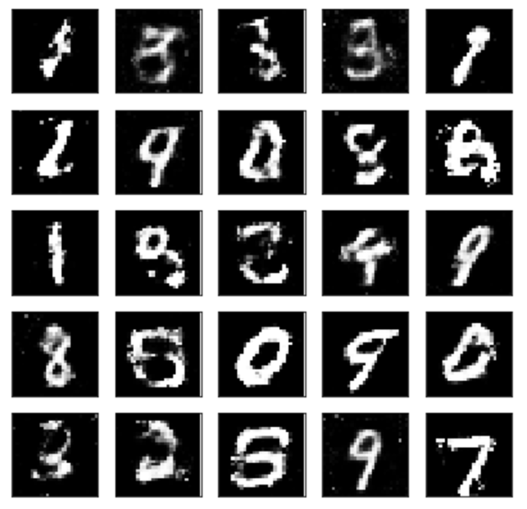
Generative Adversarial Networks (GAN)

Slide 19
Deep Convolutional GAN (DCGAN)
Tricks on GAN
Batch Normalization
Transpose convolution for UpSampling
Leaky ReLu

Slide 20
Deep Convolutional GAN (DCGAN)
Generator
def create_generator(latent_dim):
sequence = Input(shape=(latent_dim, ), dtype='float32')
model = Dense(128 * 7 * 7, activation='relu')(sequence)
model = Reshape((7, 7, 128))(model)
model = UpSampling2D()(model)
model = Conv2D(128, kernel_size=3, padding='same')(model)
model = BatchNormalization(momentum=0.8) (model)
model = Activation('relu')(model)
model = UpSampling2D()(model)
model = Conv2D(64, kernel_size=3, padding='same')(model)
model = BatchNormalization(momentum=0.8) (model)
model = Activation('relu')(model)
model = Conv2D(channels, kernel_size=3, padding='same')(model)
output = Activation('sigmoid')(model)
model = Model(inputs=sequence, outputs=output)
model.summary()
return model

Slide 21
Deep Convolutional GAN (DCGAN)
Discriminator
def create_discriminator(img_shape=(28, 28, 1)):
sequence = Input(shape=img_shape)
model = Conv2D(32, kernel_size=3, strides=2, padding='same')(sequence)
model = LeakyReLU(alpha=0.2)(model)
model = Dropout(0.25) (model)
model = Conv2D(64, kernel_size=3, strides=2, padding='same')(model)
model = ZeroPadding2D(padding=((0, 1), (0, 1))) (model)
model = BatchNormalization(momentum=0.8) (model)
model = LeakyReLU(alpha=0.2)(model)
model = Dropout(0.25) (model)
model = Conv2D(128, kernel_size=3, strides=2, padding='same')(model)
model = BatchNormalization(momentum=0.8) (model)
model = LeakyReLU(alpha=0.2)(model)
model = Dropout(0.25) (model)
model = Conv2D(256, kernel_size=3, strides=2, padding='same')(model)
model = BatchNormalization(momentum=0.8) (model)
model = LeakyReLU(alpha=0.2)(model)
model = Dropout(0.25) (model)
model = Flatten() (model)
output = Dense(1, activation='sigmoid') (model)
model = Model(inputs=sequence, outputs=output)
model.summary()
return model

Slide 22
Deep Convolutional GAN (DCGAN)
Training
for epoch in range(epochs):
idx = np.random.randint(0, x_train.shape[0], batch_size)
imgs = x_train[idx]
noise = np.random.normal(0, 1, (batch_size, latent_dim))
gen_imgs = generator.predict(noise)
# Train the discriminator
d_loss_real = discriminator.train_on_batch(imgs, valid)
d_loss_fake = discriminator.train_on_batch(gen_imgs, fake)
d_loss = 0.5 * np.add(d_loss_real, d_loss_fake)
noise = np.random.normal(0, 1, (batch_size, latent_dim))
g_loss = combined.train_on_batch(noise, valid)
print ("%d [D loss: %f, acc.: %.2f%%] [G loss: %f]" % (epoch, d_loss[0], 100*d_loss[1], g_loss))
if epoch % sample_interval == 0:
sample_images(epoch, latent_dim, generator)

